Slide 2
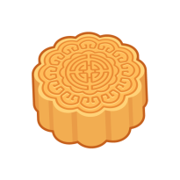
Reading
FunTube看世界
Theme words
Videos
Moon
Festival
Storybooks
數位互動練習
Challenge Time
多元評量
DIY
Songs
生活素養討論
↑點擊回此頁面

Slide 3
Reading Time
Notes:
http://ibook.idv.tw/enews/enews841-870/enews841.html

Slide 4
嫦娥奔月的故事
Once upon a time…

Slide 5
There are ten suns in the sky. It is too hot. People cannot live under the heat of the suns.
Hou-yi wants to help the people. He shoots down nine suns. People like him very much. They want Hou-yi to become their king.
heat 熱度;熱
Hou-yi 后羿
shoot 射
become 變成;變得

Slide 6
Hou-yi isn’t a good king. He treats his people badly. Hou-yi likes to have the power, but he doesn’t really care about his people.
One day, Hou-yi gets some medicine from a god. He can live forever after he takes the medicine.
treat 對待
care about 關心
medicine 藥
take medicine 吃藥

Slide 7
His wife Chang-O doesn’t want this to happen. One night, she secretly takes the medicine. Chang-O’s body becomes very light, and she gradually flies toward the moon.
happen 發生
Chang-O 嫦娥
secretly 秘密地
gradually 漸漸地

Slide 8
Theme words

Slide 9
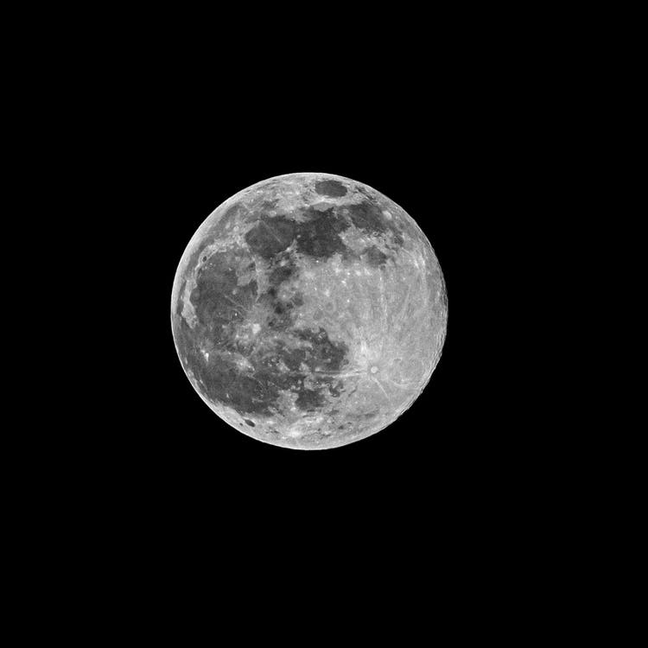
full moon

Slide 10
watch the full moon

Slide 11
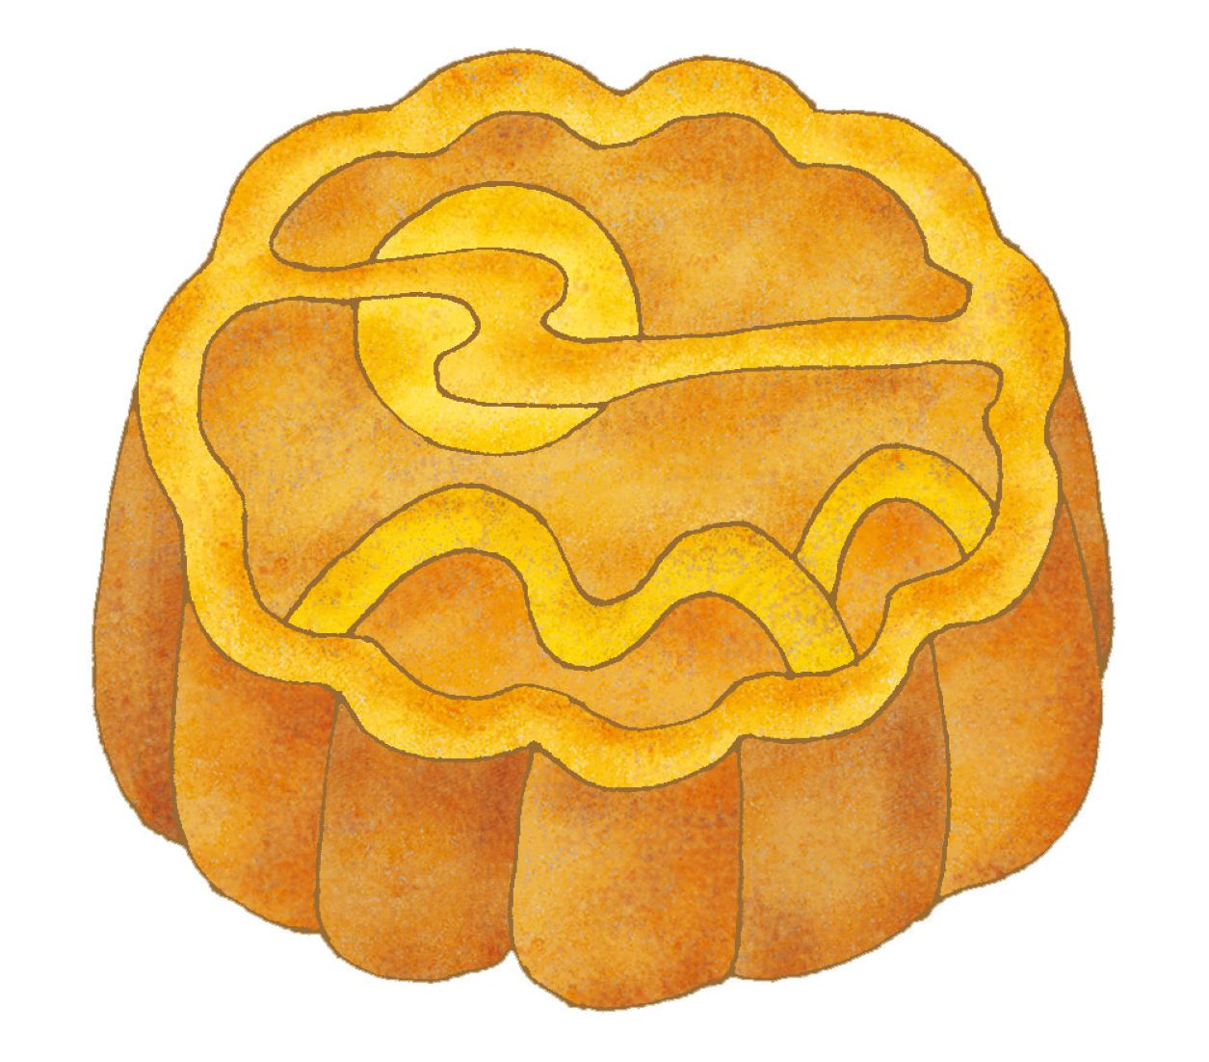
moon cake

Slide 12
eat moon cakes

Slide 13
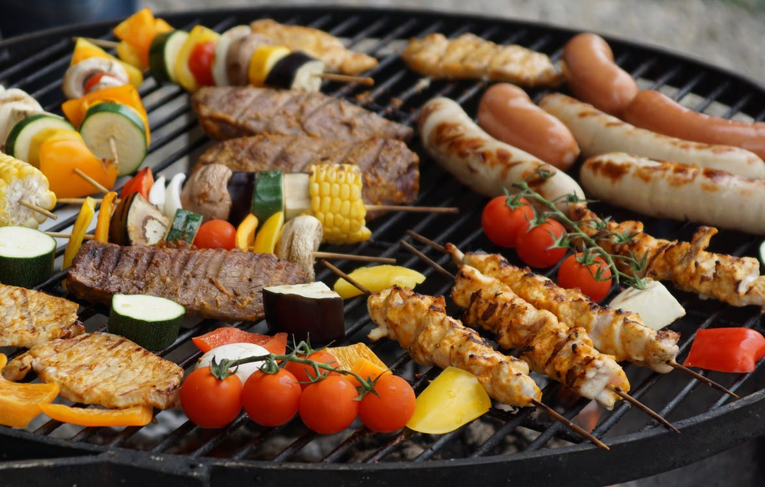
barbecue

Slide 14
have a barbecue

Slide 15
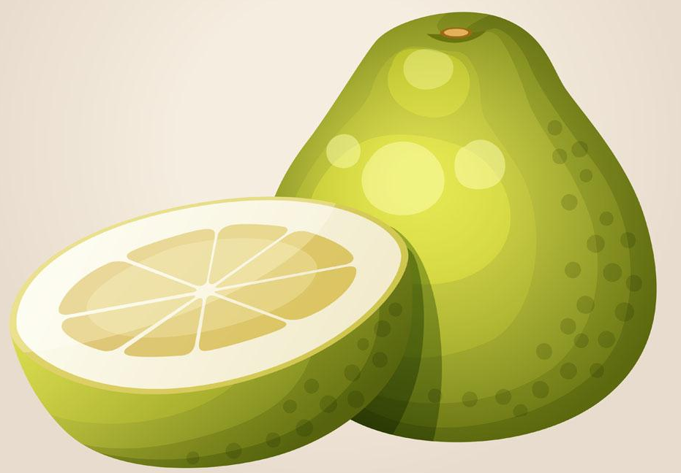
pomelo

Slide 16
eat pomelos

Slide 17
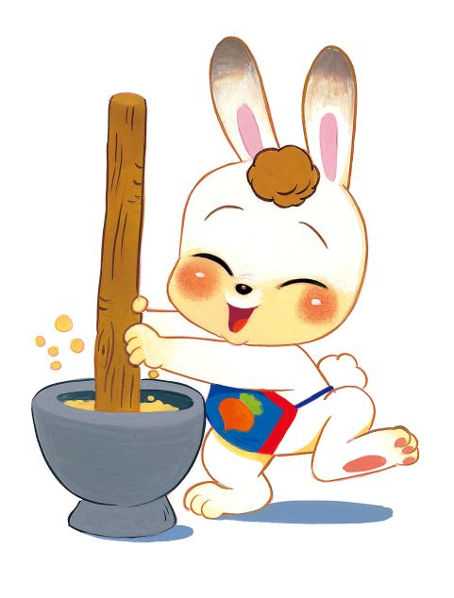
Jade Rabbit

Slide 18
Storybooks

Slide 19
Basic
Thanking the Moon
by Grace Lin
Round is a Mooncake: A Book of Shapes
by Roseanne Thong
此為網路資源，請點擊圖查看原影片
Notes:
https://www.youtube.com/playlist?list=PLOW91f4nzh6VbTNU-_gnU483IEtZIE3R_

Slide 20
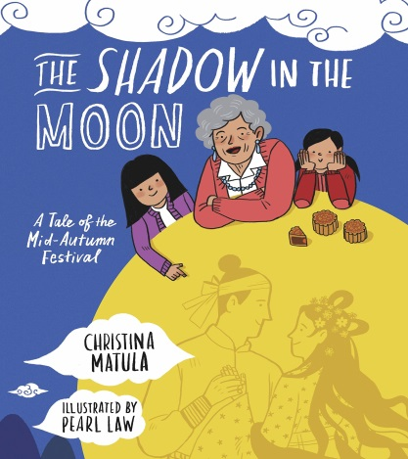
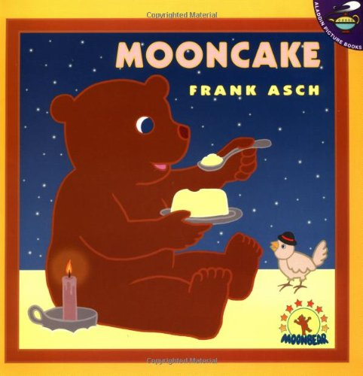
Advanced
The Shadow in the Moon
by Christina Matula
I Took the Moon for a Walk
by Carolyn Curtis
Bringing Down the Moon
by Jonathan Emmett
Mooncake
by Frank Asch
此為網路資源，請點擊圖查看原影片
Notes:
https://www.youtube.com/playlist?list=PLOW91f4nzh6VbTNU-_gnU483IEtZIE3R_

Slide 21
Do It Yourself!

Slide 22
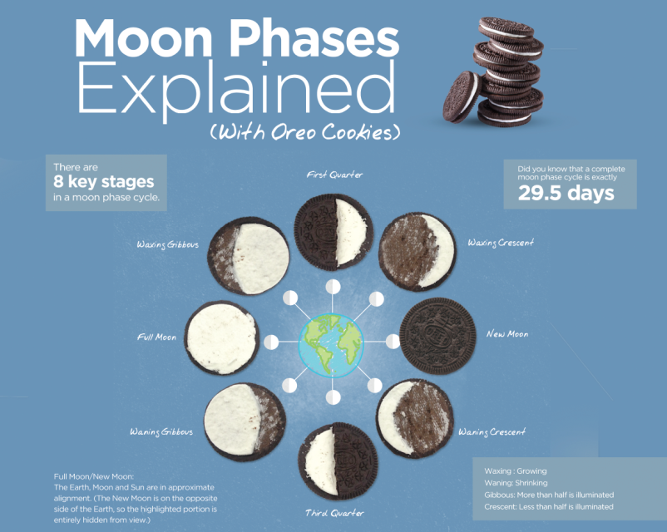
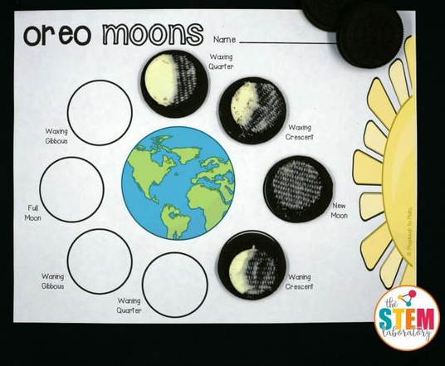
Discover the moon phases with Oreo Cookies!!!
From theSTEMlaboratory
click to read more
From OPTICSCENTRAL
click to read more
All you need is a bag of Oreo cookies.
Then you can discover the moon in a tasty way~
可以搭配中秋節海報，運用好吃又好玩的方式認識月相
此為網路資源，請查看原文，有相關活動詳細說明

Slide 23
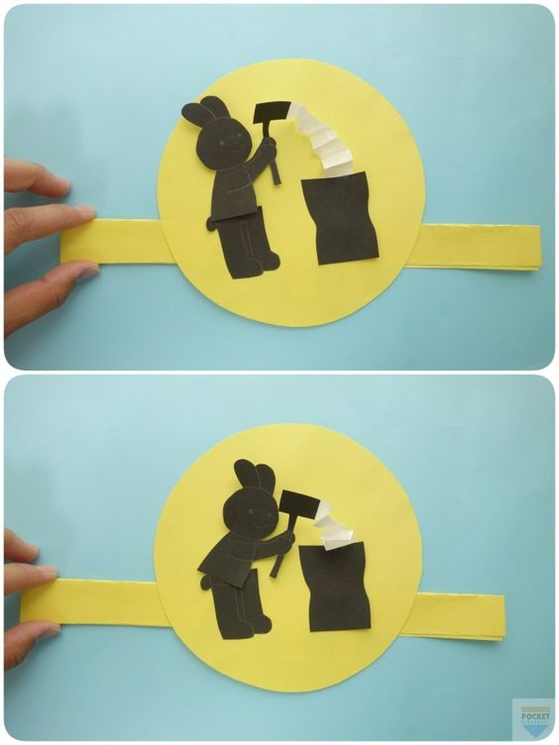
中秋節月亮起飛了DIY
材料: 保麗龍球、顏料、毛根、吸管、紙(白色)
製作完成後，可以進行班級比賽等增加節慶教學的趣味性
From 蠟筆哥哥
click to read more
月兔搗麻糬動起來
材料: 紙(黃色、黑色、白色)、金屬束帶
簡單的手作機關，讓月兔動起來，也可發揮創意做成吳剛伐桂等其他中秋節勞作
click to read more
原文為日文，可用網頁翻譯方便閱讀
此為網路資源，請查看原文，有相關活動詳細說明

Slide 24
Paper Rabbit Origami (摺紙)
材料: 色紙(顏色不拘)
摺紙完成後，發揮創意裝飾自己的玉兔，可以作為教室佈置的素材喔
From N2Q VIDEO
click to read more
Paper Moon Origami (摺紙)
材料: 色紙(顏色不拘)
摺紙完成後，可以和上面的紙玉兔組合成中秋節佈置
From Origami UP
click to read more
此為網路資源，請查看原文，有相關活動詳細說明

Slide 25
Sing along!

Slide 27
The Round Moon
The Moon Song
Mid Autumn Festival Folk Song
The Moon Song
此為網路資源，請點擊圖查看原影片

Slide 28
FunTube看世界

Slide 29
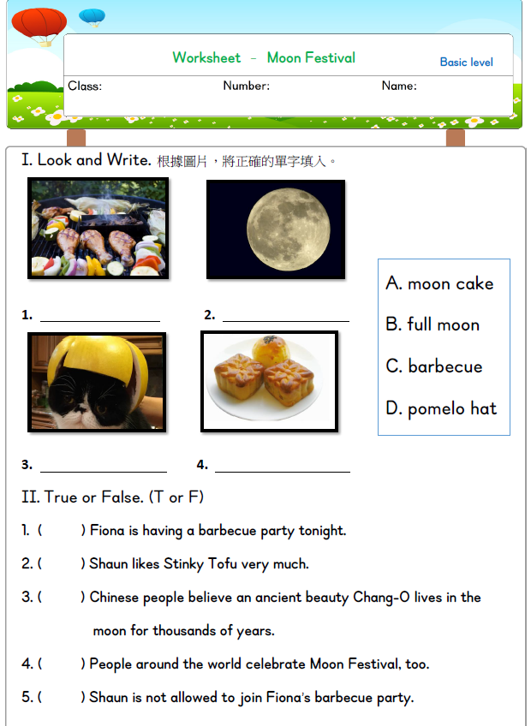
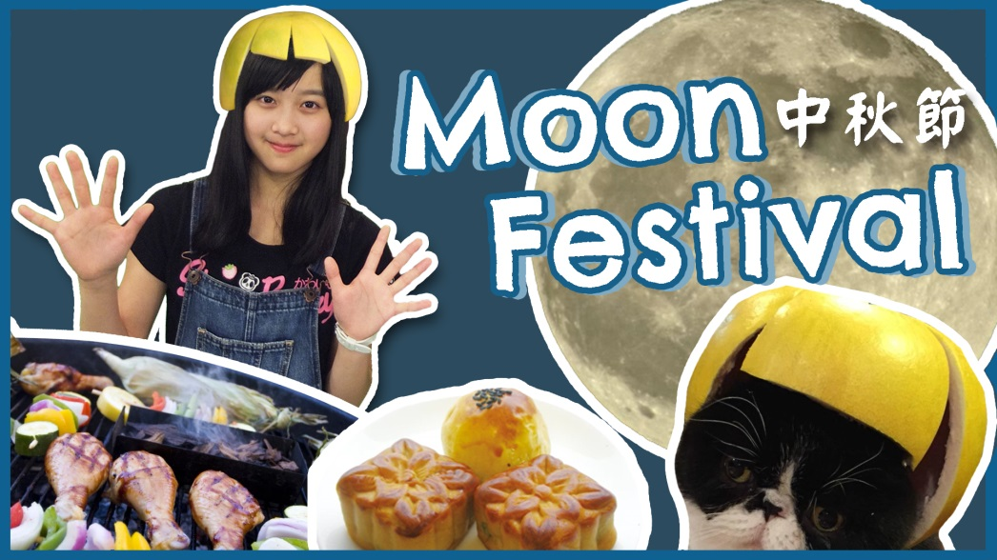
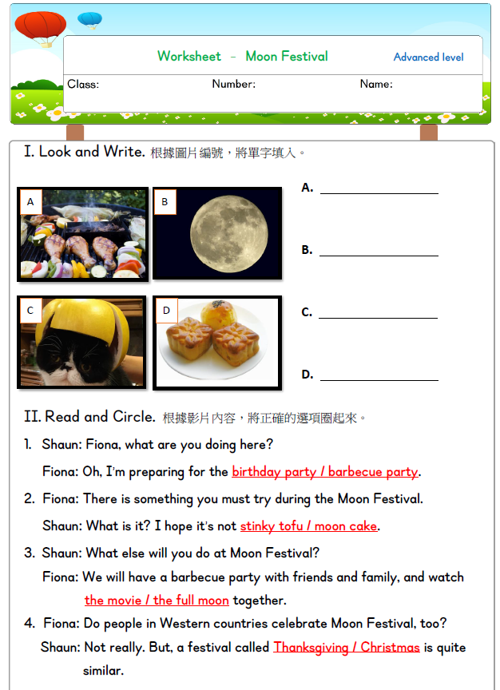
搭配差異化學習單(附件)

Slide 30
Videos

Slide 31
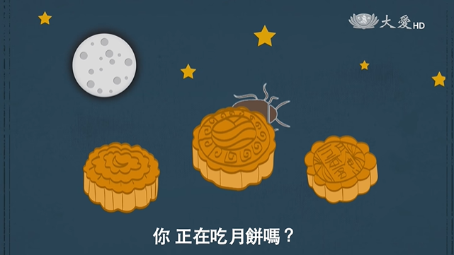
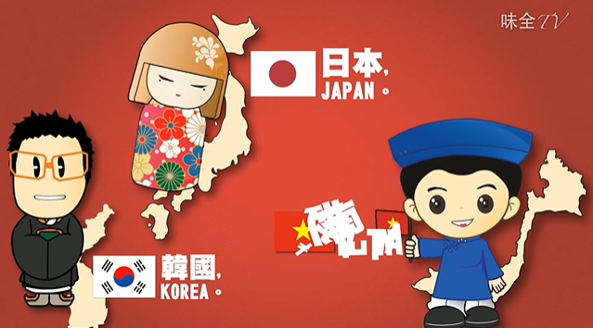
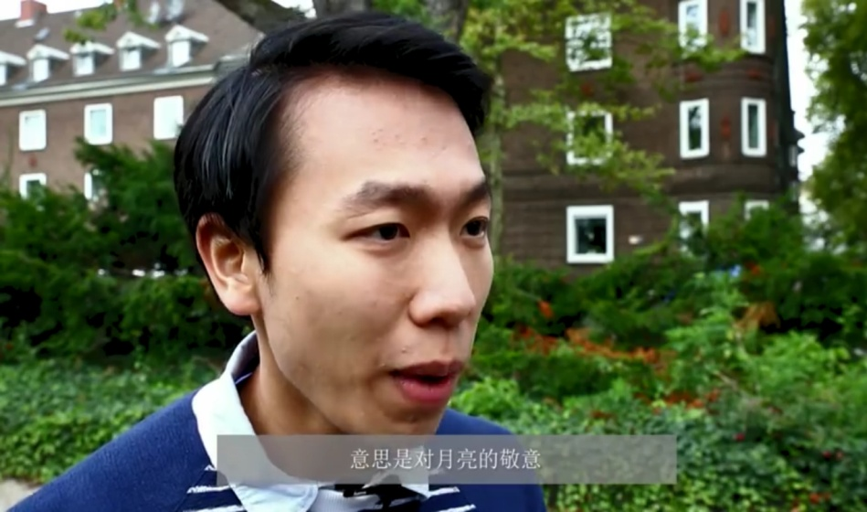
【阿滴英文-中秋節單字】
【月餅的由來】(中文)
【世界各地的中秋習俗】(中文)
【 What is Mid Autumn Festival?】
此為網路資源，請點擊圖查看原影片

Slide 32
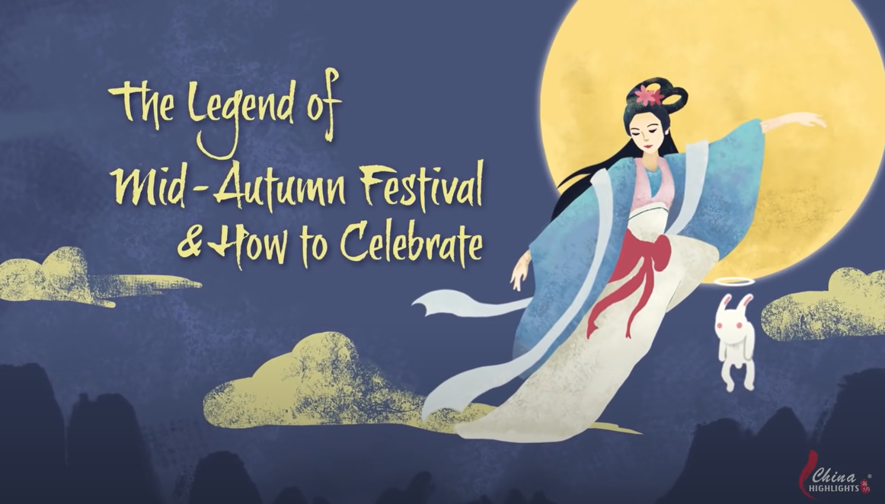
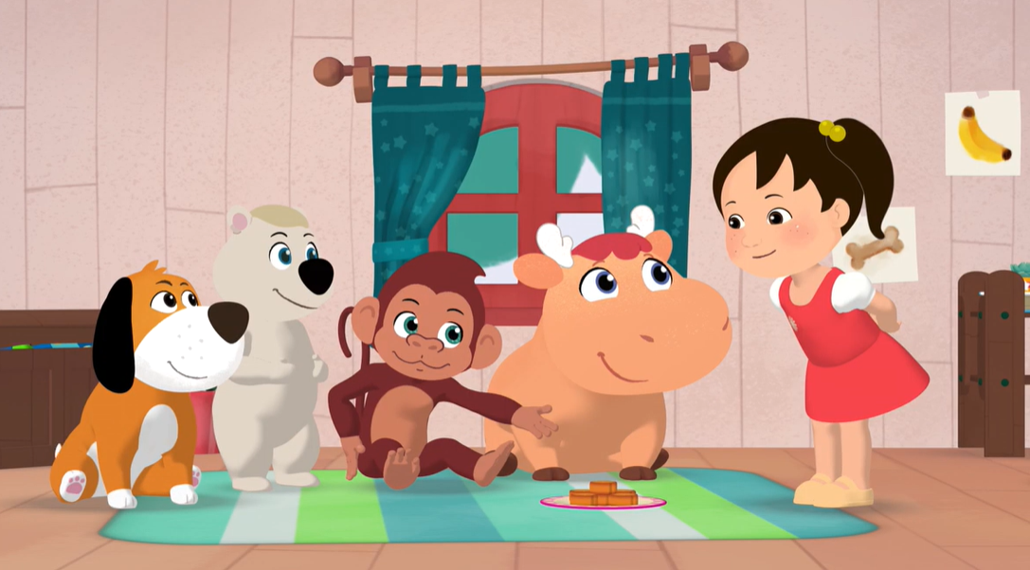
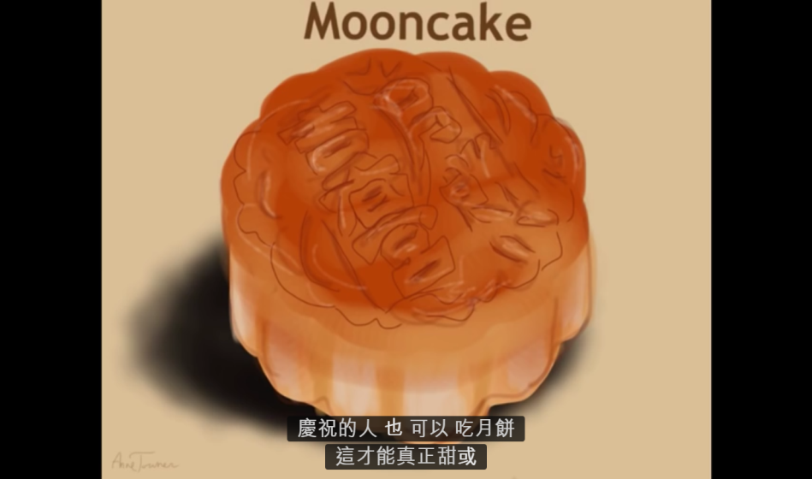
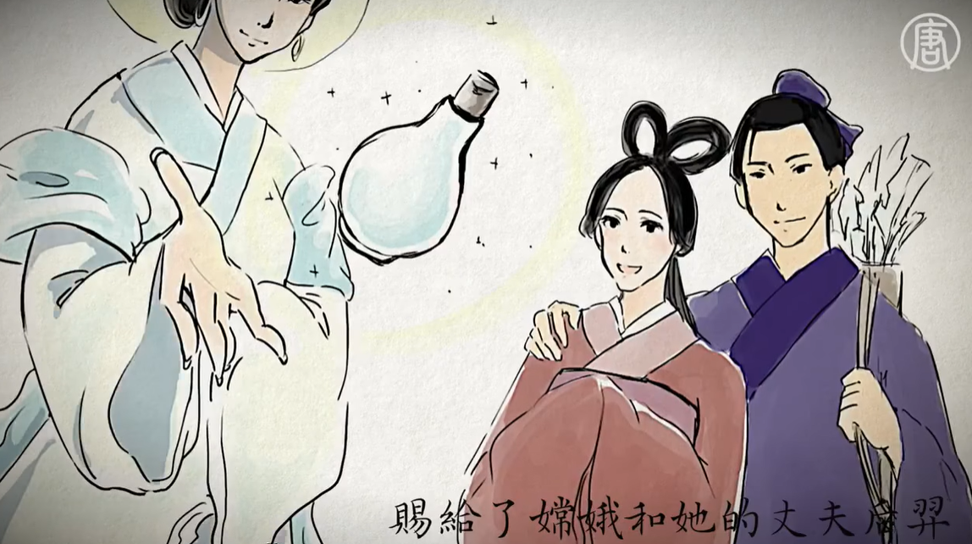
【Mid Autumn Festival story and how Chinese celebrate it】
【Mid-Autumn Moon Festival Cartoon】
【 The Mid-Autumn Festival】(英文)
(需點下方字幕翻譯)
【嫦娥為何要奔月？】 (中文)
此為網路資源，請點擊圖查看原影片

Slide 33
數位互動練習

Slide 34
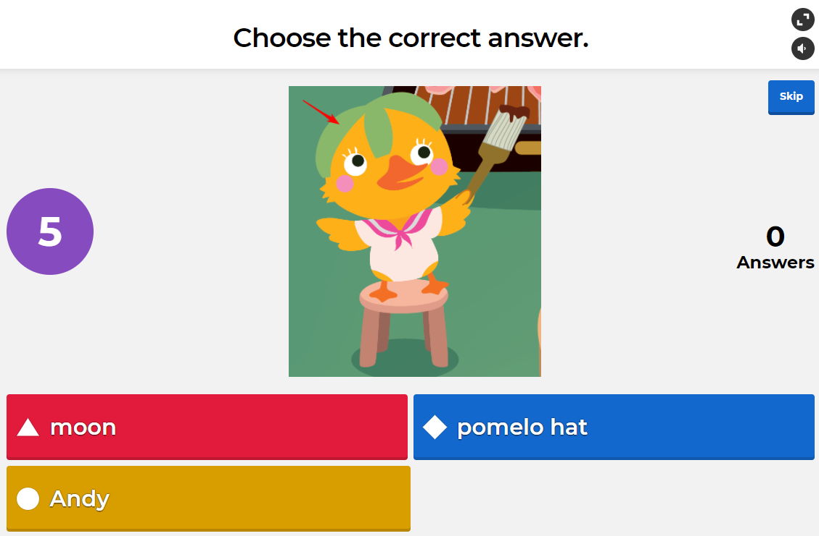
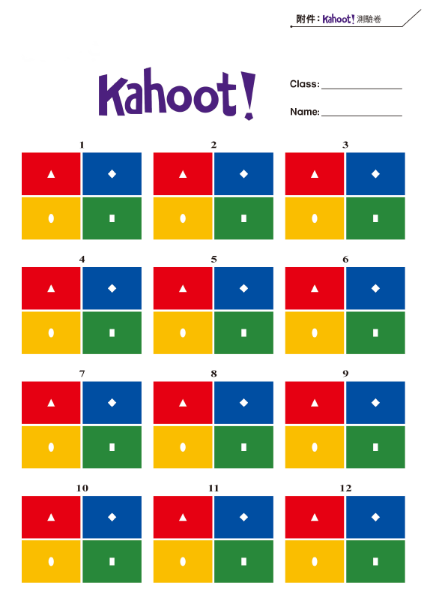
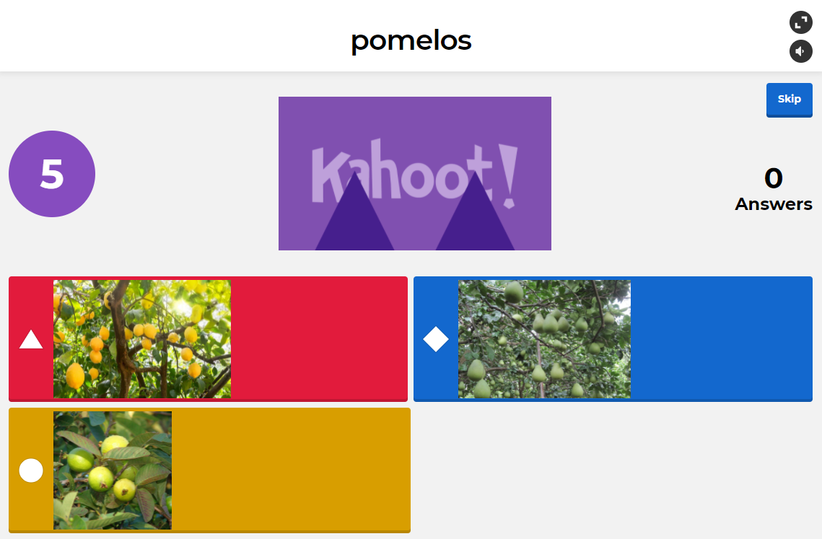
沒有平板也能玩(附件)
Play

Slide 35
Challenge Time!

Slide 36
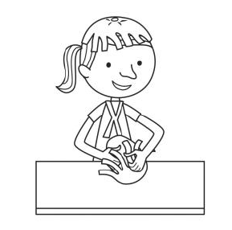
1. Happy Moon Festival! I want to eat some _____ and make hats.
① cakes
② pomelos
③ pumpkins
④ rice dumplings

Slide 37
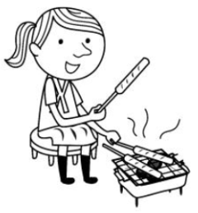
2. What do you do on Moon Festival?
① I eat cakes with my family.
② I have a barbecue with my family.
③ I row a dragon boat with my friends.
④ I go trick-or-treating with my friends.

Slide 38
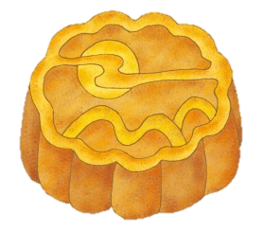
3. _____ is coming. I want to buy some moon cakes and pomelos.
① Easter
② Christmas
③ Moon Festival
④ Dragon Boat Festival

Slide 39
4.
① Mother’s Day
② Moon Festival
③ Chinese New Year
④ Dragon Boat Festival
?
have a barbecue
watch the full moon
pomelos
moon cakes

Slide 40
Think and Share
生活素養討論

Slide 41
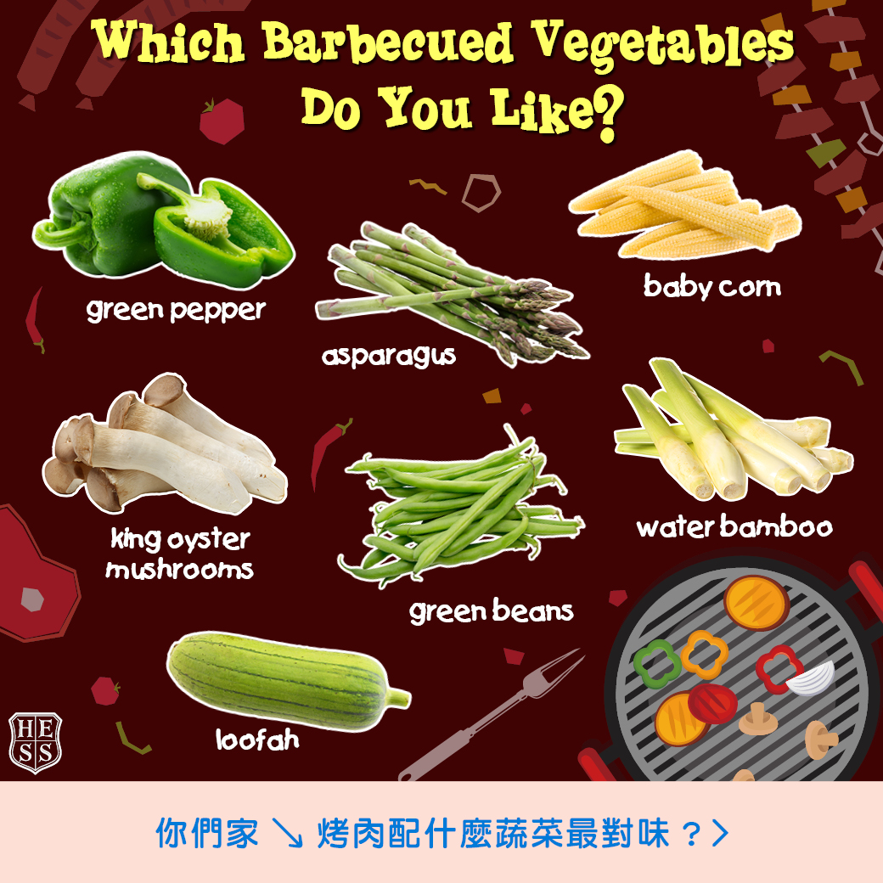
在台灣，中秋節大家常常會烤肉來慶祝，這是台灣特別的慶祝方式喔！
Which barbecued vegetables do you like?
除了烤肉類的食材外，你們家會烤蔬菜嗎？
你喜歡哪一種烤蔬菜呢？
除了烤肉和烤蔬菜，你還有烤過什麼特別的食材呢？快跟大家分享吧～
Notes:
可以想想看還有沒有什麼其他的問題討論

Slide 42
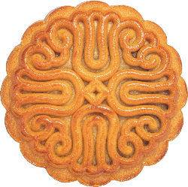
There are many flavors.
Some are salty, some are sweet.
月餅有很多口味，有些是鹹的，有些是甜的。
moon cake
What special flavors have you tried?
你有嘗試過什麼特別口味的月餅嗎？

