Slide 1
Happy Thanksgiving

Slide 2
Reading Time
Kahoot!
Theme Words
Challenge Time
Storybooks
Think & Share
DIY
Video
Sing Along

Slide 3
Reading Time

Slide 4
Thanksgiving is a national holiday in Canada and the US. It is celebrated on the second Monday of October in Canada and on the fourth Thursday of November in the US.
Its origin dates back to 1620s. Families sailed from England were looking for freedom. The native people taught them how to grow crops. After the harvest, they want to show their thankfulness with a celebration.
date back 追溯、起源 | native people 原住民
sail 航行 | crop 農作物
look for 尋找 | harvest 收成、收穫
freedom 自由 | thankfulness 感謝、感激

Slide 5
People usually have a Thanksgiving dinner with their family. They prepare turkey, sweet potatoes, mashed potatoes, corn, and pumpkin pie.
It is a time to remind ourselves of the blessings we have gotten during the year and show our thankfulness to our families and friends.
sweet potato 地瓜、番薯
mashed potatoes 馬鈴薯泥
blessing 祝福、幸事

Slide 6
Theme Words

Slide 7
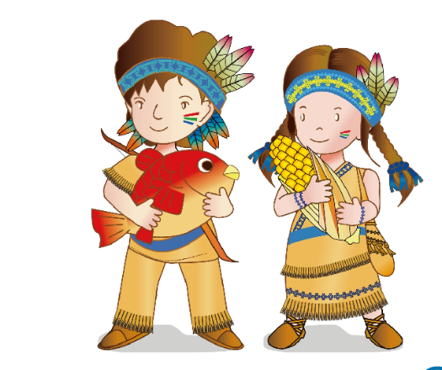
Native American(s)

Slide 8
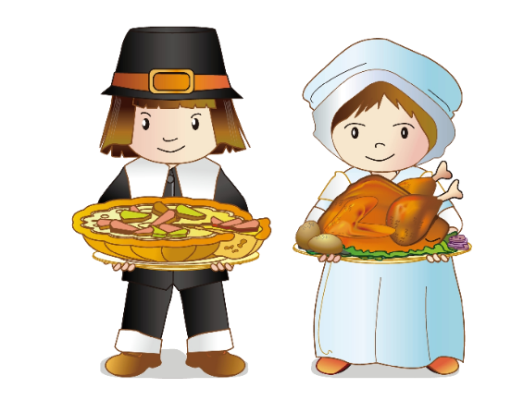
Pilgrim(s)

Slide 9
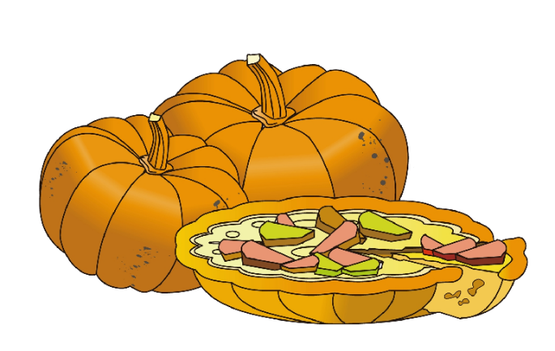
pumpkin pie

Slide 10
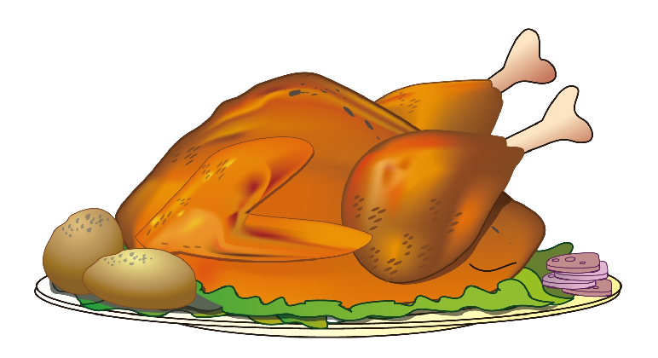
turkey

Slide 11
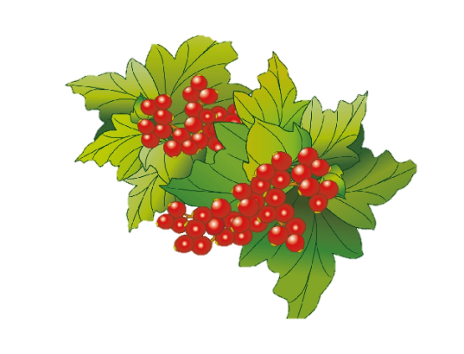
cranberries

Slide 12
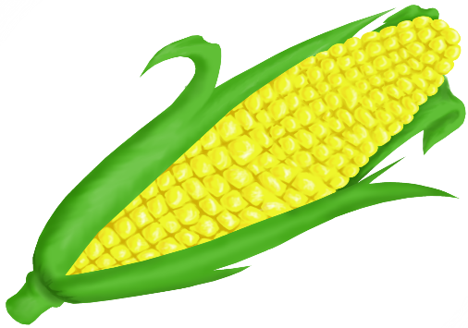
corn

Slide 13
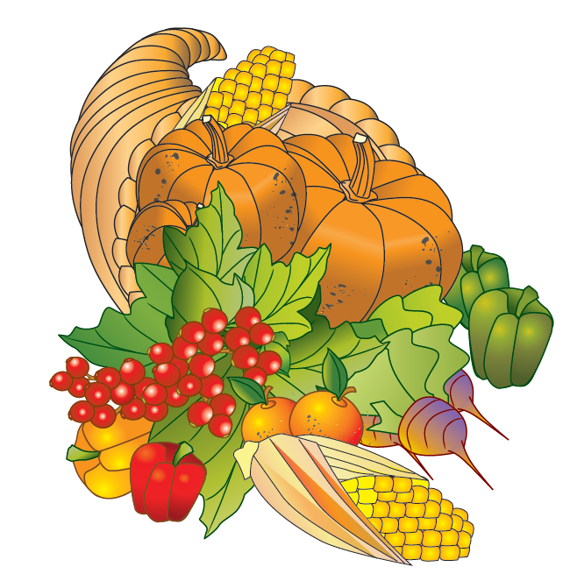
cornucopia

Slide 14
Storybooks

Slide 15
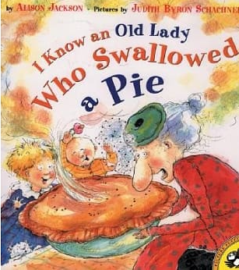
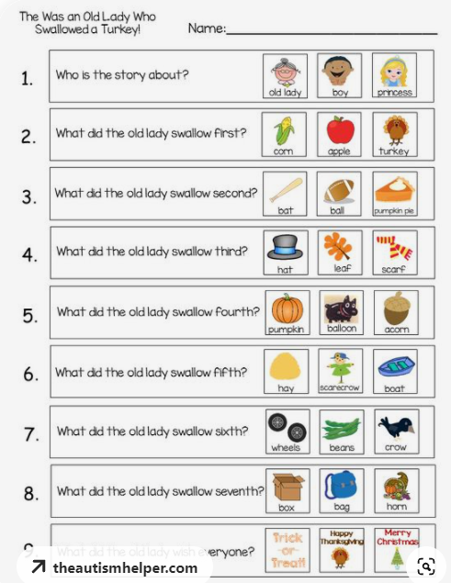
I Know an Old Lady Who Swallowed a Pie
by Alison Jackson
這本書的靈感來自於美國的童謠「從前有個老太太，吞下一隻蒼蠅來」。所以，這本書也是一本singalong book，也就是裡面的每一句都是可以唱出來的。音樂可以加深孩子們的記憶，在這本書里，中國孩子們可以一邊唱一邊學習到火雞，南瓜派等等美食的英文名稱。更重要的是，荒誕的情節能讓孩子們記住健康飲食和餐桌禮儀的重要性。

Slide 16
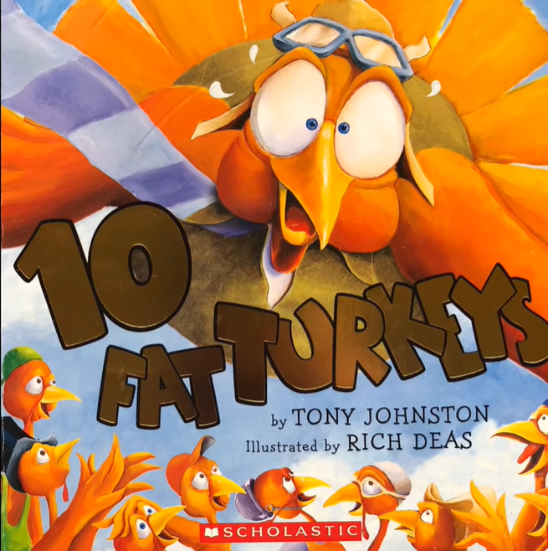
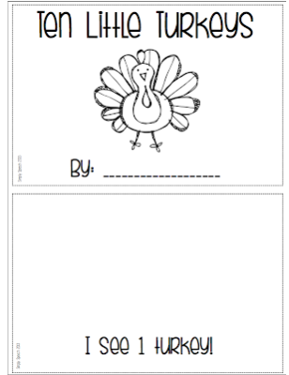
10 Fat Turkeys
by Tony Johnson
十隻胖火雞在籬笆上各出奇招，又是跳舞，又是盪鞦韆，以吸引主人的注意，實在是讓讀者捧腹！這本書出彩之處是朗朗上口，採用押韻的形式，既介紹了火雞的不同動作，又鍛鍊了小讀者的語音意識。另外，這也是一本數學書—隨著火雞一隻一隻的從籬笆上掉下來，孩子們可以跟著一起倒數。

Slide 17
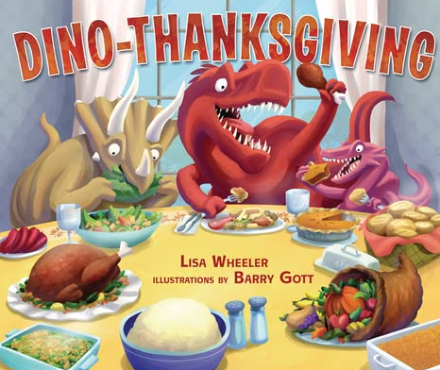
Dino-Thanksgiving
by Lisa Wheeler
跟隨恐龍穿越河流和穿過樹林與家人團聚。他們喜歡最喜歡的活動，包括玉米迷宮、製作巨大氣球的電視遊行，當然還有足球比賽！恐龍分享的不是一場而是兩場盛宴——一場是為食肉動物而另一場是為素食巨蜥。加入樂趣，因為恐龍們在這個特殊的假期裡發現了很多值得感謝的東西！

Slide 18
Do It Yourself

Slide 19
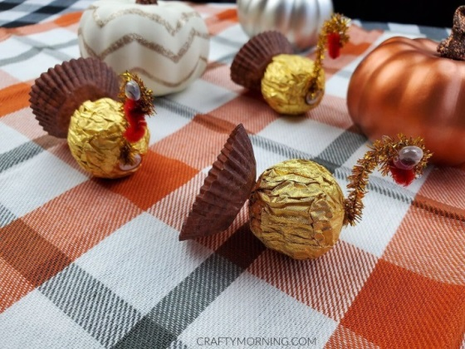
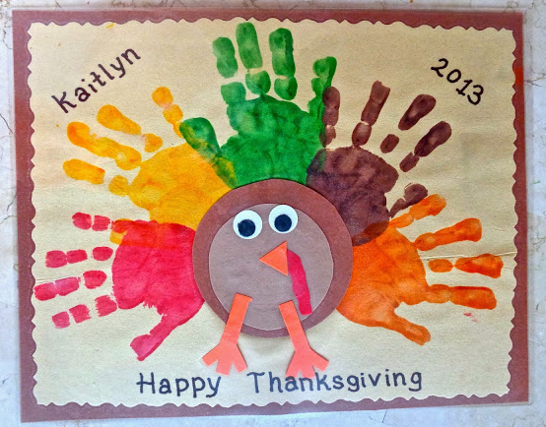
Ferrero Rocher Turkey (金莎火雞)
材料: 金莎巧克力、活動眼睛、金蔥毛根、紅色毛根
只要將巧克力的包裝紙反折，再利用毛根和活動眼睛裝飾，就變成好吃又有創意的感恩節火雞囉！
From Crafty Morning
click to read more
From CloudMom
click to read more
Handprint Turkey
材料: 紙(橘/咖啡/紅色)、活動眼睛(也可用黑/白紙代替)、顏料(顏色不拘或可用秋天的顏色)
可進行小組創作，並請每個人蓋一個手印，寫上自己要感謝的人事物；也可由全班共同創作一隻大火雞
此為網路資源，請查看原文，有相關活動詳細說明

Slide 20
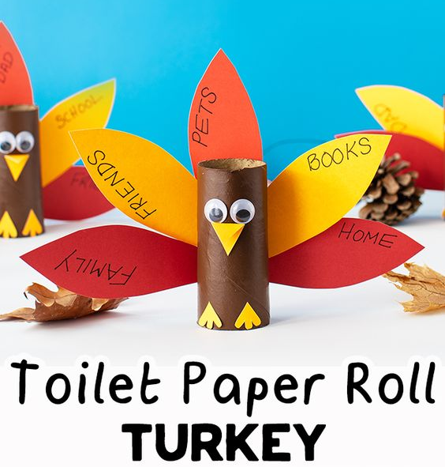
Thankful Pumpkin (感恩南瓜)
材料: 紙(橘、綠)、兩腳釘
寫上想要感謝的人事物後，就可以做為教室布置的素材喔，還可以運用不同長度、粗細的紙條作成大小不同的南瓜！
From Awesomely Crafty
click to read more
From thebestideasforKiDS
click to read more
Toilet Paper Roll Turkey
材料: 紙(橘/咖啡/紅/黃色)、活動眼睛(也可用黑/白紙代替)
將用完的衛生紙捲廢物利用，可以做出不同表情的火雞，並寫上想感謝的人事物
此為網路資源，請查看原文，有相關活動詳細說明

Slide 21
Sing Along

Slide 22
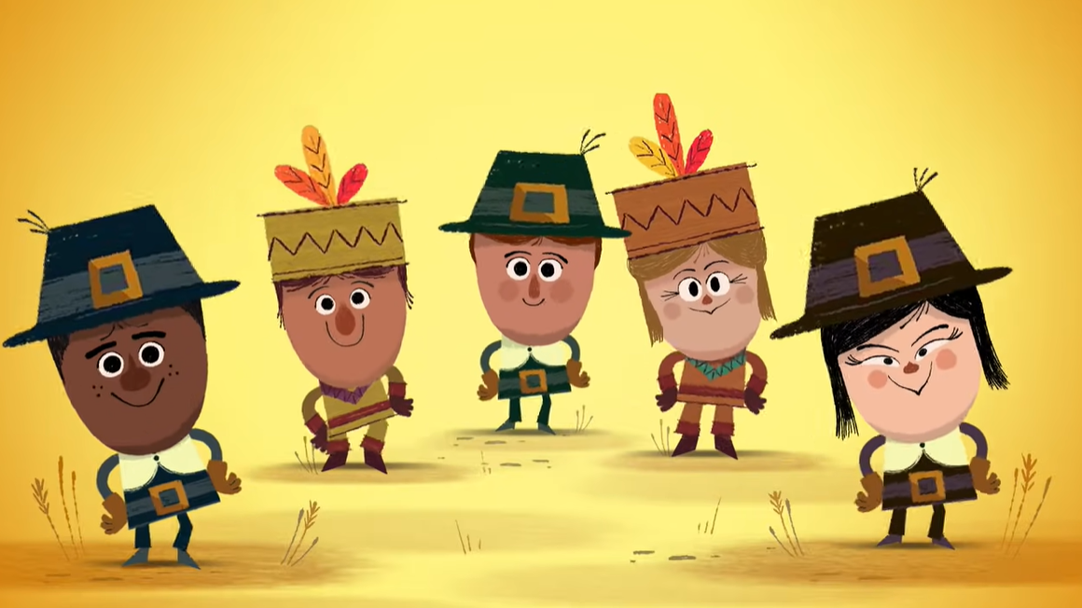
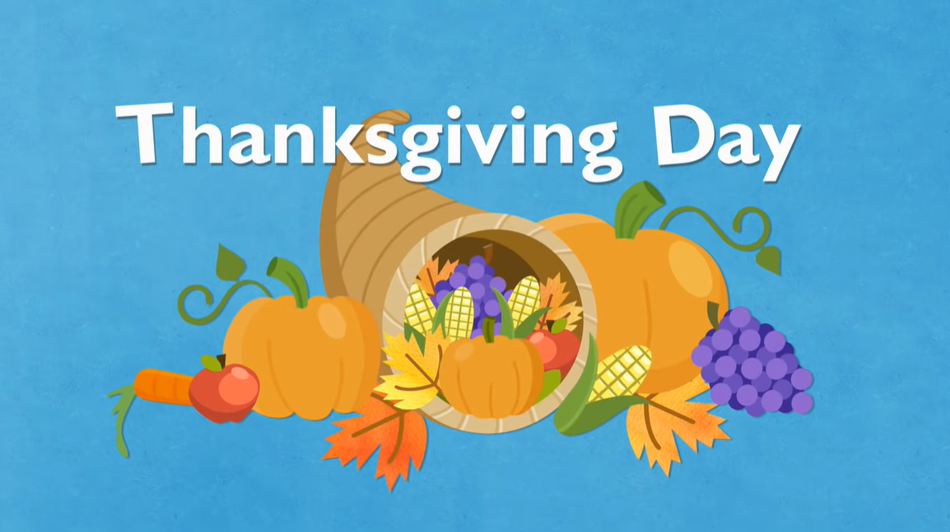
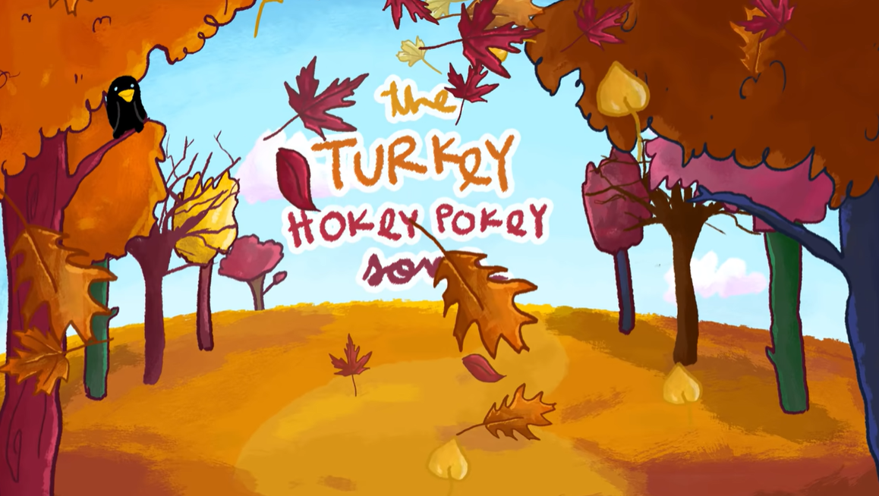
1:30
1:38
"Thank You for Thanksgiving,"
Happy Thanksgiving from the StoryBots!
Thanksgiving Day - Holiday Songs –
Mother Goose Club Thanksgiving Song
2:25
2:07
Turkey Hokey Pokey | Thanksgiving Songs for Kids |
The Kiboomers
Thanksgiving Songs for Children - Little Pilgrim
Kids Song by The Learning Station

Slide 23
Video

Slide 24
【看片學英語】Newsflash - 感恩節傳統活動好有趣! 幸運火雞是什麼?! 👉Let's learn about “Thanksgiving” with teacher Laura.
【Keywords 重點單字】
🦃 harvest (n.) 收穫
🦃 turkey pardon (phr.) 火雞赦免
🦃 wishbone (n.) 叉骨
🦃 tradition (n.) 傳統
🦃 parade (n.) 遊行
3:17

Slide 25
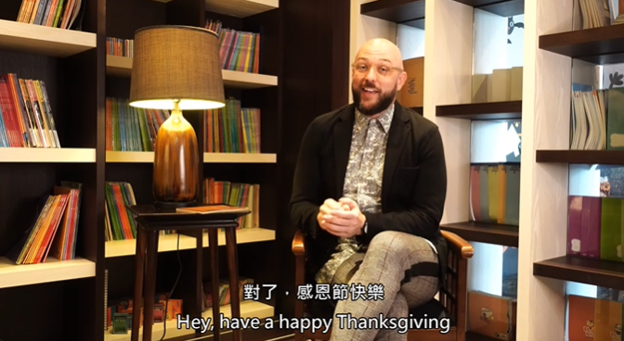
【感恩節 · 幽默篇】
🍁Thanksgiving除了一起烤火雞、吃南瓜派及五月花號的故事
👉猜 猜 你 還 少 了 什 麼?🤔 .
🍁Oh! 還差學一句 ”Talk Turkey” 🦃美式道地俚語
👉Teacher Derek的美式幽默，你有get到嗎?😆
1:58

Slide 26
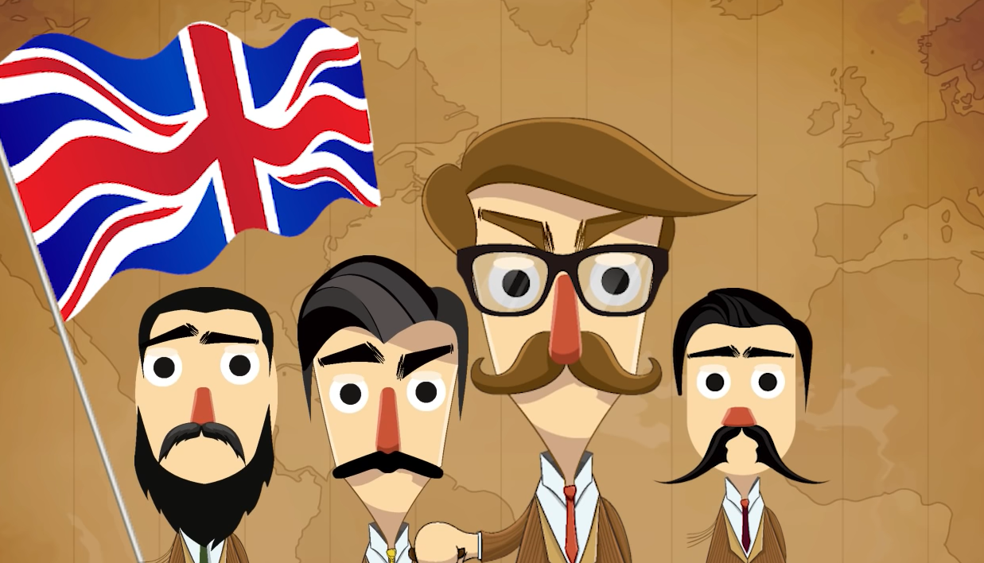
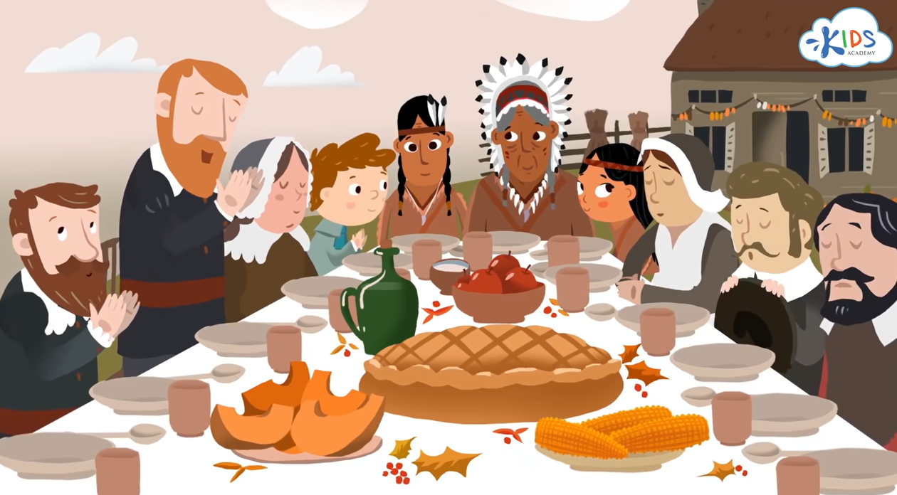
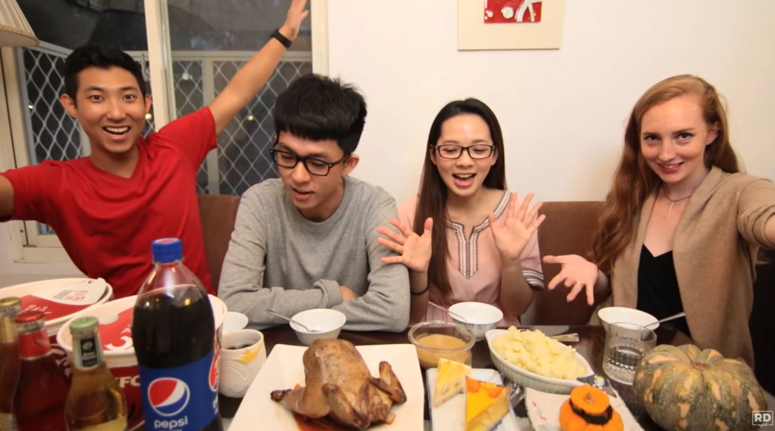
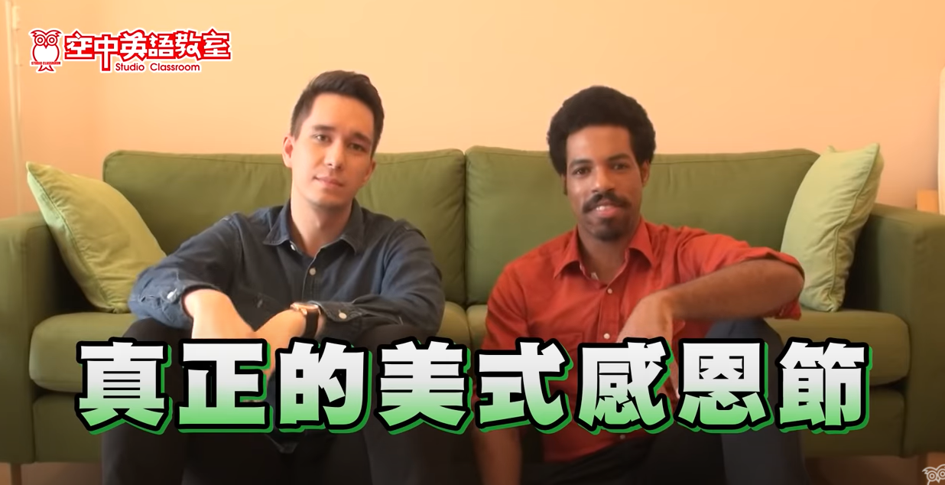
1:50
3:23
感恩節的由來(中文)
Thanksgiving Story for Kids
11:11
6:18
阿滴英文｜English Corner 輕鬆做感恩節大餐?!
【好想講英文】美式感恩節算是美國人的中秋節嗎?

Slide 27
Kahoot!

Slide 28
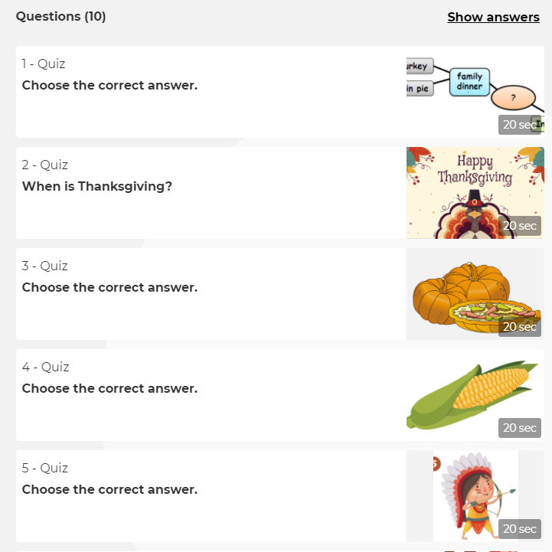
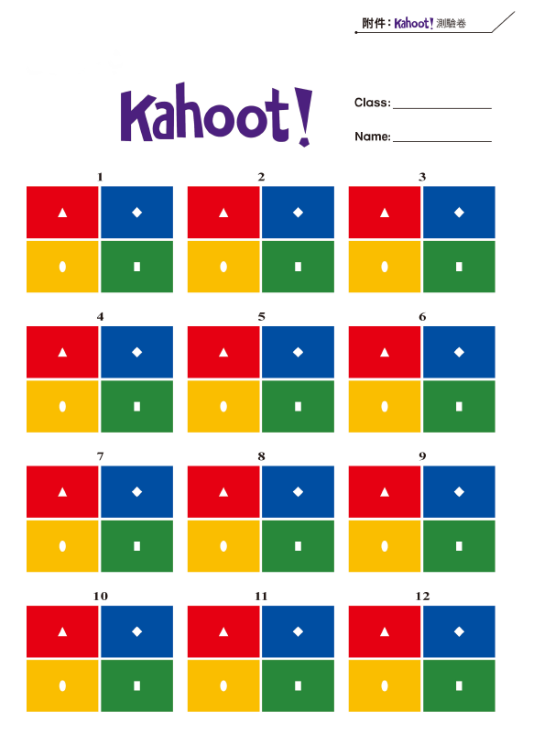
提供Kahoot!附件！
沒有平板也能玩
Play

Slide 29
Challenge Time

Slide 30
1. _____ is coming. We want to prepare for it. Here is our shopping list.
① Easter
② Halloween
③ Thanksgiving
④ Chinese New Year
Shopping List
1. turkey
2. pumpkin pie
pumpkin
flour
3. cranberry sauce
cranberry
sugar
shopping list 購物清單
flour 麵粉
cranberry 蔓越莓
sauce 醬汁
sugar 糖

Slide 31
2. This is the cornucopia. Look carefully. There are pumpkins, corns, and cranberries. People use this for _____.
① Halloween
② Christmas
③ Thanksgiving
④ Chinese New Year

Slide 32
3. Ruby is reading a book. There is a picture as following (如下). What is the name of the book?
① Easter
② Christmas
③ Halloween
④ Thanksgiving

Slide 33
4.
① Halloween
② Thanksgiving
③ Mother’s Day
④ Chinese New Year
corn
Native Americans
cranberry
?
past*
family dinner
turkey
Pilgrims
pumpkin pie
*past 過去

Slide 34
Think & Share

Slide 35
Thanksgiving是表達感恩之意的節日，請你回想看看，你想對哪些人、哪些事、哪些東西表達你的感謝呢？
Who do you want to say thank you to?
What are you thankful for?
Families? Friends? Teachers?
Bus driver? Or other people that help you in your daily life. (日常生活)
A book? A song? A picture? A toy?

Slide 36
現在，請你想想看，要如何表達你的感謝呢？表達感謝之意重要嗎？為什麼？
How can you show your thankfulness?
How do you feel when you say “thank you” to others?
How do you feel when people say “thank you” to you?
Say “thank you”
Write a thank you card
What else?

Slide 37
Happy Thanksgiving

